Slide 1

UWEBIC IY425
Electrical and Electronic Engineering Principles 2
Capacitors
Mohammad Hosseinabady
Thursday 20-Jan-2022
mohammad.hosseinabady@kaplan.com

Slide 2
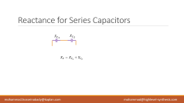
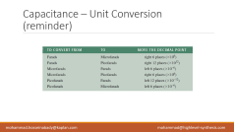
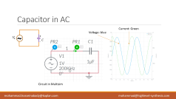
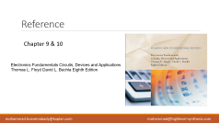
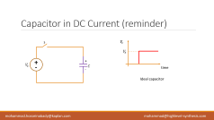
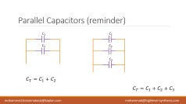
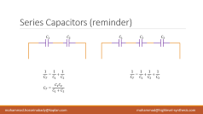
Today Topics

Slide 3
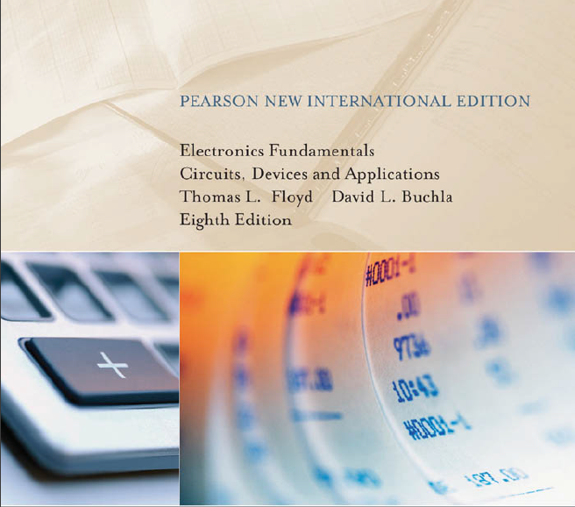
Reference
Chapter 9 & 10
Electronics Fundamentals Circuits, Devices and Applications
Thomas L. Floyd David L. Buchla Eighth Edition

Slide 4
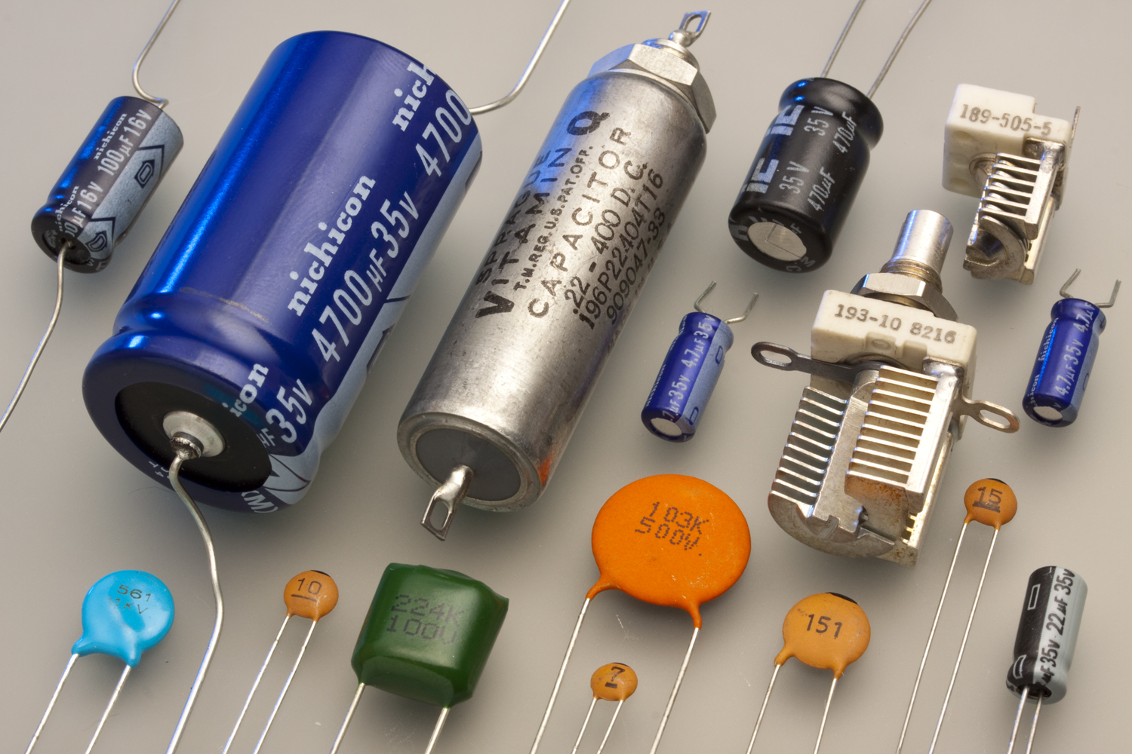
Capacitor (reminder)
A capacitor is a passive electrical component.
It stores electrical charge and has the property of capacitance.
Dielectric
Connecting Leads
C
Conductive Plates
Circuit Symbol

Slide 5
Capacitor (for study)
dielectric
a dielectric (or dielectric material or dielectric medium) is an electrical insulator that can be polarised by an applied electric field. When a dielectric material is placed in an electric field, electric charges do not flow through the material as they do in an electrical conductor, because they have no loosely bound, or free, electrons that may drift through the material, but instead they shift, only slightly, from their average equilibrium positions, causing dielectric polarisation.
conductive
A conductive substance allows heat or electricity to travel through it

Slide 6
Homework (reminder)
Dielectric
Conductive Plates
1- How does a capacitor store charge?
+
-
+
-
2- How does a capacitor store energy?
-
+
+
-
Hint: Chapter 9 Capacitors in the course textbook.

Slide 7
Leakage (reminder)
No insulating material is perfect.
The dielectric of any capacitor will conduct some very small amount of current.
Thus, the charge on a capacitor will eventually leak off.
Some types of capacitors have higher leakages than others.
An equivalent circuit for a nonideal capacitor is shown in this Figure.
The parallel resistor represents the extremely high resistance (several
hundred or more) of the dielectric material through which there is leakage current.
None-ideal Capacitor

Slide 8
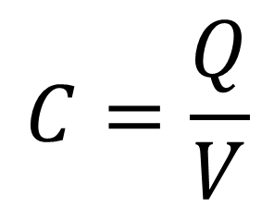
Capacitance (reminder)
Capacitance
C
The amount of charge that a capacitor can store per unit of voltage across its plates.
Circuit Symbol
Charge
$$C=\frac{Q}{V}$$
Capacitance
Voltage

Slide 9
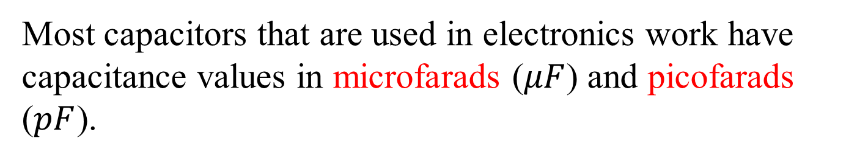
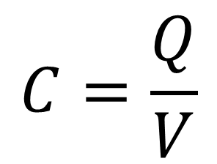
Capacitance (reminder)
Coulomb
C
$$C=\frac{Q}{V}$$
Circuit Symbol
Farad
Volt
Most capacitors that are used in electronics work have capacitance values in microfarads ($μF$) and picofarads ($pF$).

Slide 10


Capacitance (reminder)
C
A microfarad is one-millionth of a farad:
$$1 μF = 1×{10}^{−6} F$$
Circuit Symbol
A picofarad is one-trillionth of a farad:
$$1 pF = 1×{10}^{−12} F).$$

Slide 11
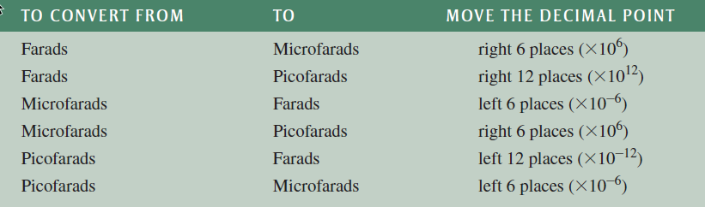
Capacitance – Unit Conversion (reminder)

Slide 12

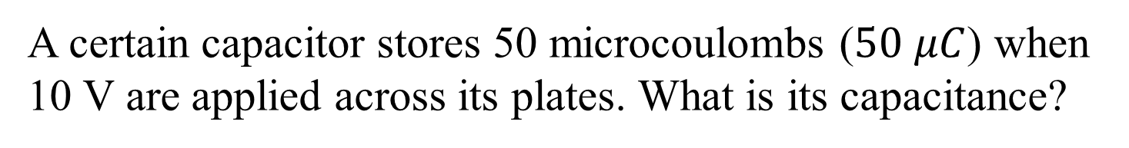
Example
A certain capacitor stores 50 microcoulombs ($50 μC$) when 10 V are applied across its plates. What is its capacitance?
$$C=\frac{Q}{V}=\frac{50μs}{10v}=5μF$$

Slide 13
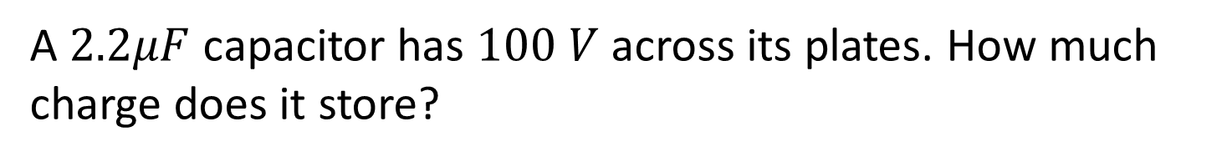
Example
A $2.2μF$ capacitor has $100 V$across its plates. How much charge does it store?
$$Q=CV=\left(2.2μF\right)\left(100V\right)=5μF$$

Slide 14
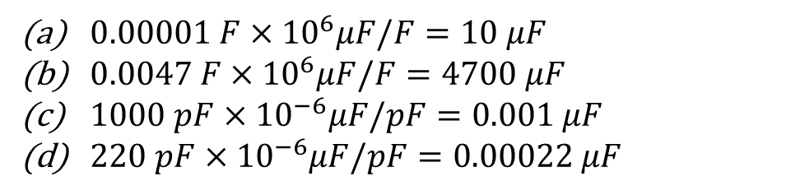
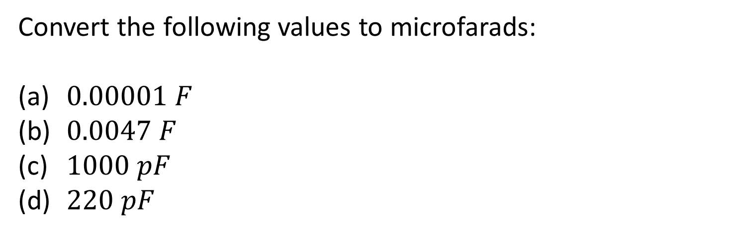
Example
Convert the following values to microfarads:
$0.00001 F$
$0.0047 F$
$1000 pF$
$220 pF$
$0.00001 F×{10}^{6}μF/F=10 μF$
$0.0047 F×{10}^{6}μF/F=4700 μF$
$1000 pF×{10}^{−6}μF/pF=0.001 μF$
$220 pF×{10}^{−6}μF/pF=0.00022 μF$

Slide 15





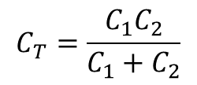
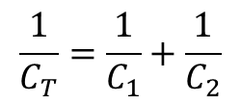
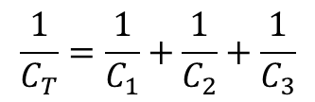
Series Capacitors (reminder)
$$C_{1}$$
$$C_{2}$$
$$C_{1}$$
$$C_{2}$$
$$C_{3}$$
$$\frac{1}{C_{T}}=\frac{1}{C_{1}}+\frac{1}{C_{2}}$$
$$\frac{1}{C_{T}}=\frac{1}{C_{1}}+\frac{1}{C_{2}}+\frac{1}{C_{3}}$$
$$C_{T}=\frac{C_{1}C_{2}}{C_{1}+C_{2}}$$

Slide 16
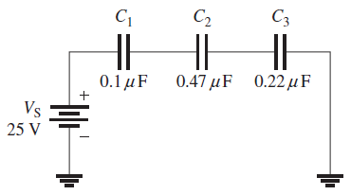
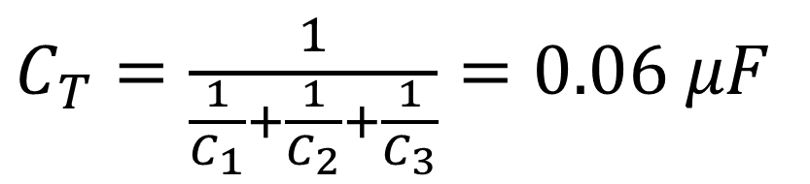
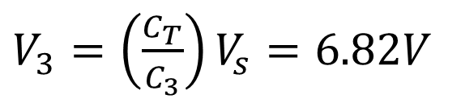
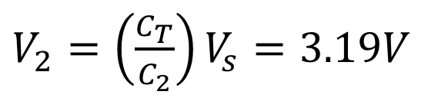
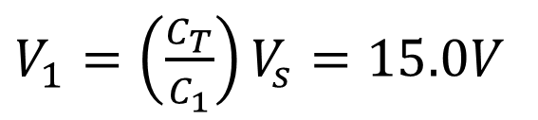
Example (reminder)
Find the voltage across each capacitor:
$C_{T}=\frac{1}{\frac{1}{C_{1}}+\frac{1}{C_{2}}+\frac{1}{C_{3}}}=0.06 μF$
$V_{1}=\left(\frac{C_{T}}{C_{1}}\right)V_{s}=15.0V$
$V_{2}=\left(\frac{C_{T}}{C_{2}}\right)V_{s}=3.19V$
$V_{3}=\left(\frac{C_{T}}{C_{3}}\right)V_{s}=6.82V$

Slide 17



Parallel Capacitors (reminder)
$$C_{1}$$
$$C_{1}$$
$$C_{2}$$
$$C_{2}$$
$$C_{3}$$
$C_{T}=C_{1}+C_{2}$
$$C_{T}=C_{1}+C_{2}+C_{3}$$

Slide 18




Capacitor in DC Current (reminder)
s
$$V_{c}$$
$$V_{s}$$
+
+
$$C_{}$$
$$V_{s}$$
-
-
time
Ideal capacitor

Slide 19






Capacitor in DC Current (reminder)
s
$$R$$
In Practice
$$V_{c}$$
When a capacitor charges or discharges through a resistance, a certain time is required for the capacitor to charge fully or discharge fully.
$$V_{s}$$
+
+
$$C_{}$$
$$V_{s}$$
-
-
time
The time constant of a series RC circuit determines the rate at which the capacitor charges or discharges.
$$τ=RC$$

Slide 20
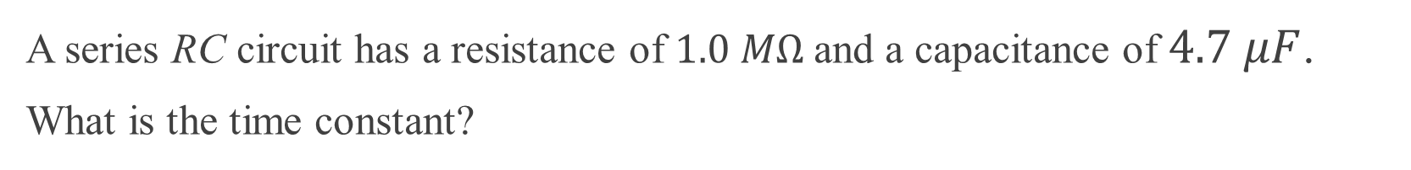
Example (reminder)
A series RC circuit has a resistance of $1.0 MΩ$and a capacitance of $4.7 μF$.
What is the time constant?
$$t =RC = (1.0 ∗ {10}^{6})(4.7× {10}^{−6} F) = 4.7 s$$

Slide 21
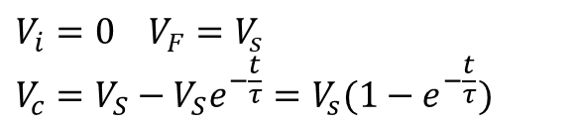






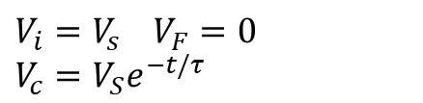
Capacitor in DC Current (reminder)
s
$$R$$
$$V_{c}=V_{F}+\left(V_{i}−V_{F}\right)e^{−t/τ}$$
+
+
$$C_{}$$
Charging from 0:
$$V_{s}$$
-
-
$$V_{i}=0 V_{F}=V_{s}$$
$$V_{c}=V_{S}−V_{S}e^{−\frac{t}{τ}}=V_{s}(1−e^{−\frac{t}{τ}})$$
$$V_{c}$$
Discharging to 0:
Charging
Discharging
$$V_{i}=V_{s} V_{F}=0$$
$$V_{c}=V_{S}e^{−t/τ}$$
$$V_{s}$$
time

Slide 22
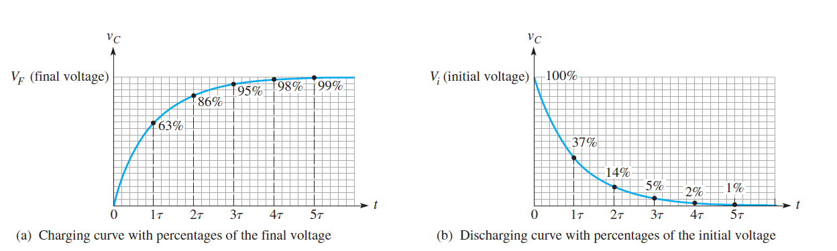
Capacitor in DC Current (reminder)
Exponential voltage curves for the charging and discharging of a capacitor in an RC circuit.

Slide 23
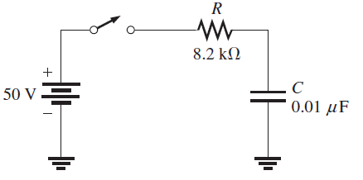
Example
How long does it take to fully charge the capacitor?
$$t = RC = (8.2 kΩ)(0.01 μF) = 82 μs$$

Slide 24
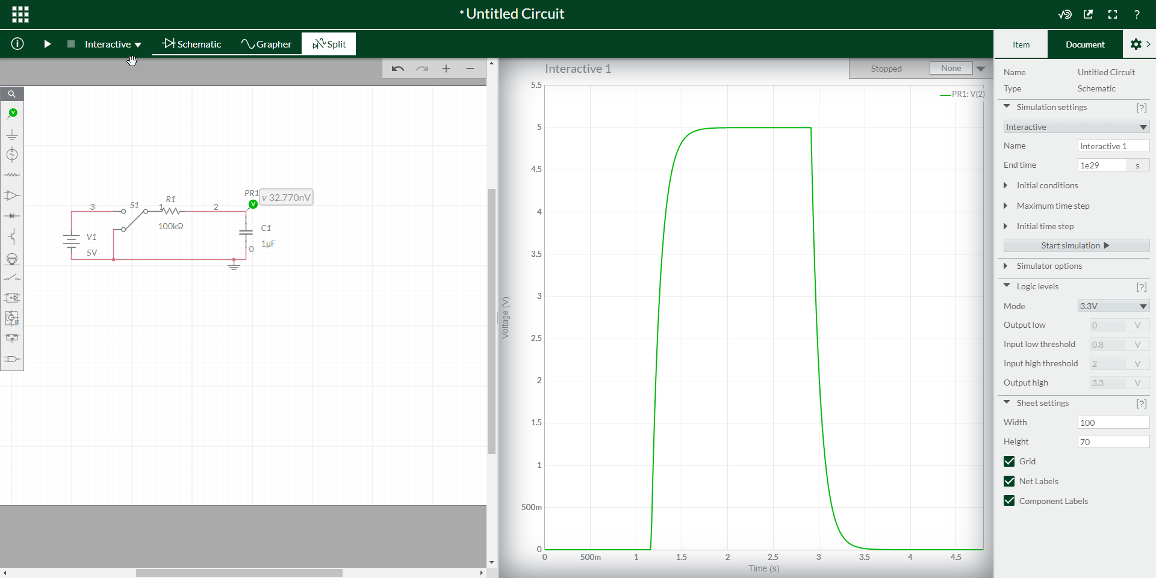
Capacitor in DC Current

Slide 25
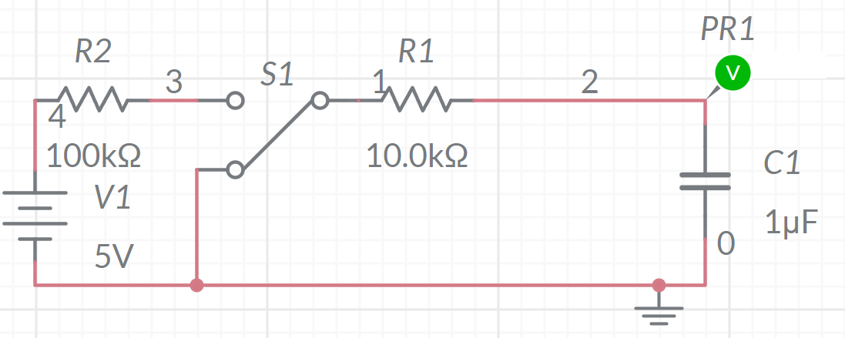
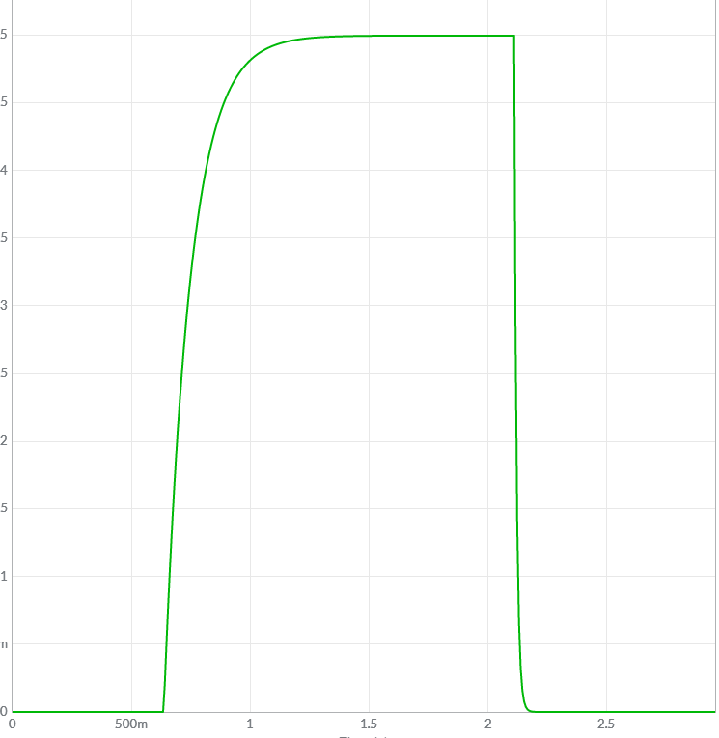
Example
Write the charging and discharging formulations for this circuit.

Slide 26
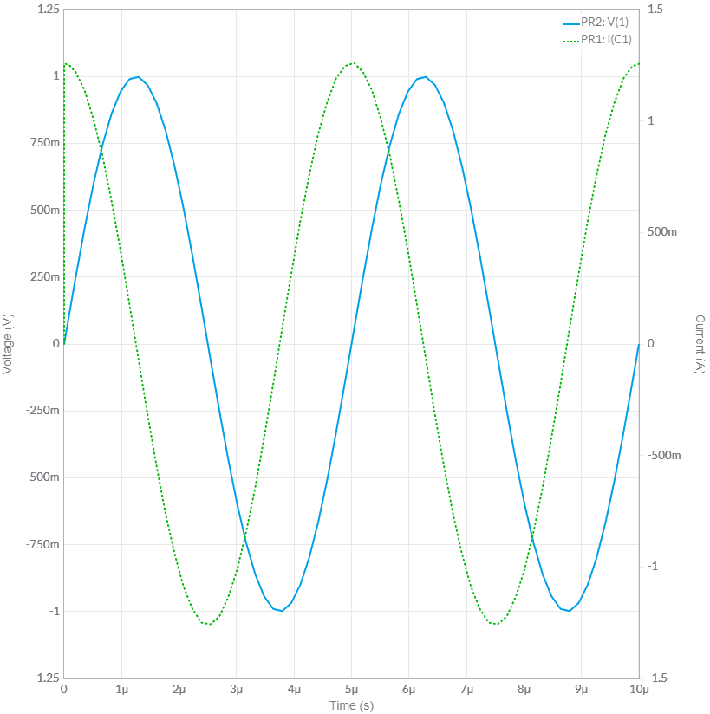
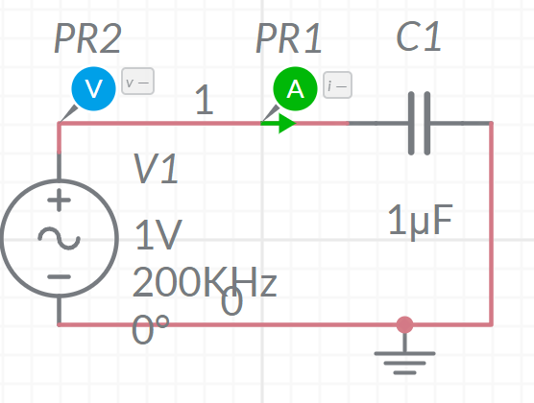


Capacitor in AC
Current: Green
Voltage: blue
$$V_{s}$$
~
+
$$C$$
-
Circuit in Multisim

Slide 27
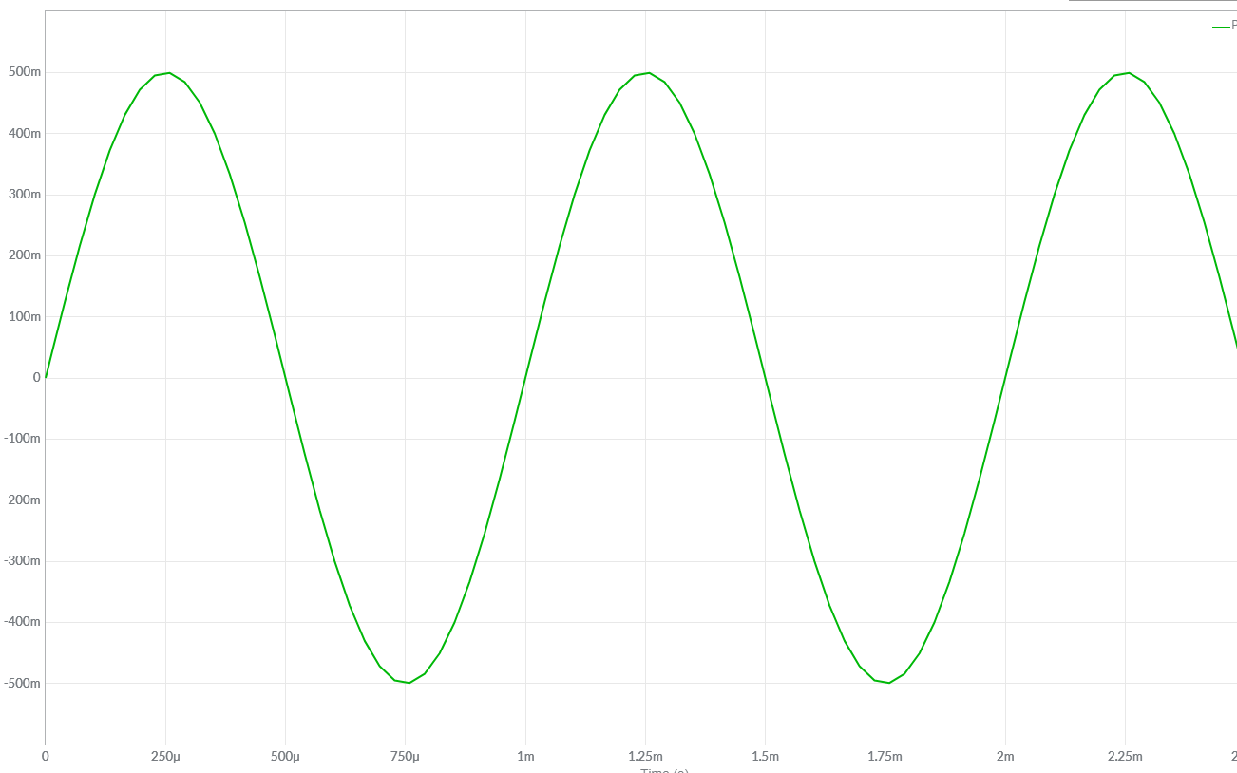
Sine Wave – Period (reminder)
Positive maximum
Voltage or Current
Time (t)
T: period
A cycle
Negative maximum

Slide 28
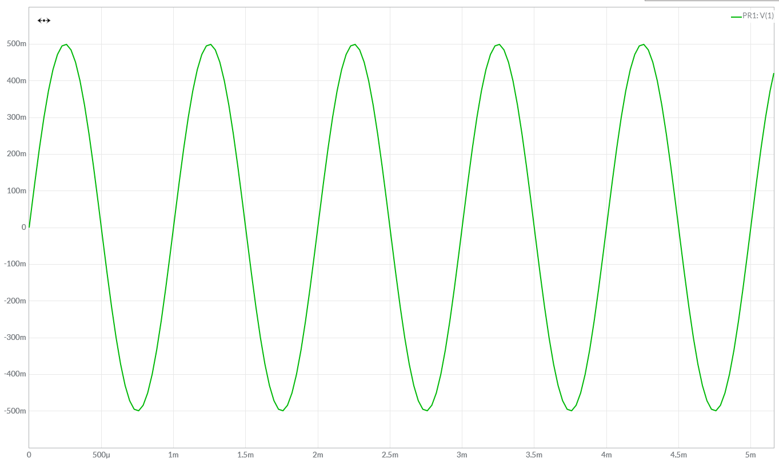
Sine Wave – Frequency (reminder)
Lower frequency: fewer cycles per second
Higher frequency: more cycles per second

Slide 29
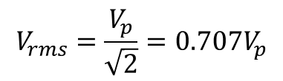




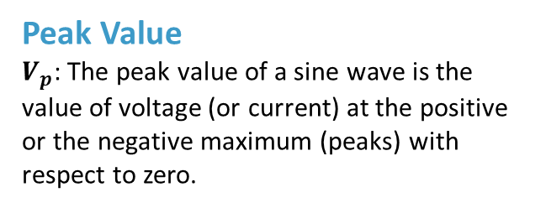
Sine Wave – Values (reminder)
Peak Value
$V_{p}$: The peak value of a sine wave is the value of voltage (or current) at the positive or the negative maximum (peaks) with respect to zero.
$V_{p}$
$V_{pp}$
Peak-to-Peak Value
$V_{pp}=2V_{p}$
$V_{p}$
RMS Value
The term rms stands for root mean square.
The rms value, also referred to as the effective
value, of a sinusoidal voltage is actually a measure of the heating effect of the sine wave.
$$V_{rms}=\frac{V_{p}}{\sqrt{2}}=0.707V_{p}$$

Slide 30
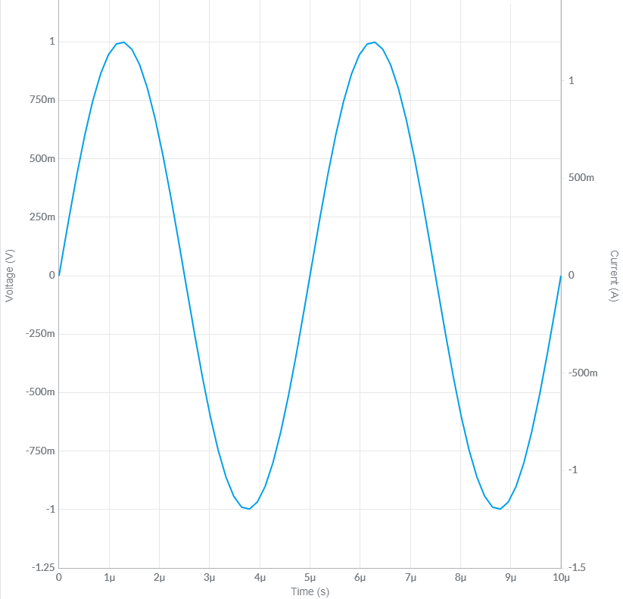
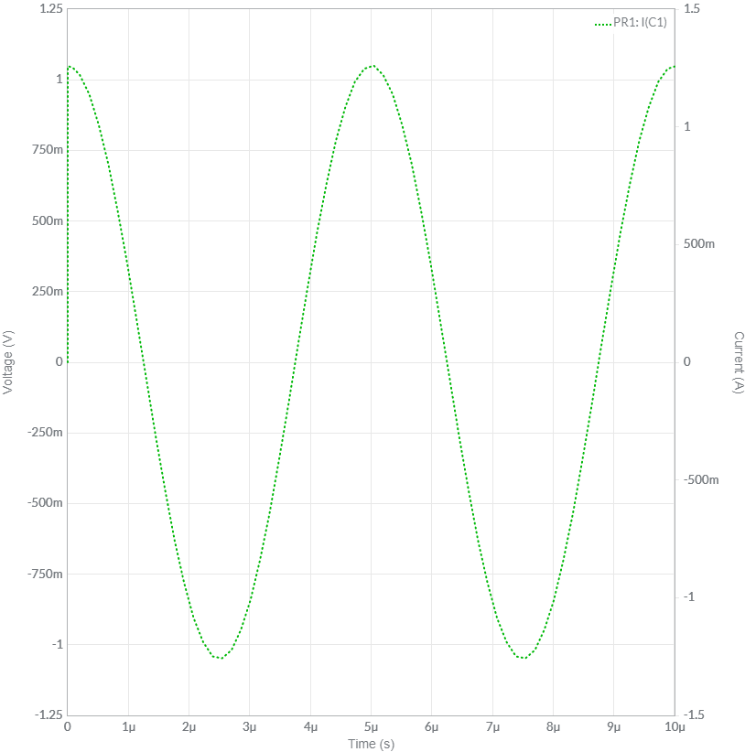






Capacitor in AC
$$V_{s}$$
~
+
$$C$$
-
$$f:frequency$$
$$φ:phase$$
Current
$$V_{m}:amplitiude$$
Voltage
$$V=V_{m}sin⁡(θ+φ)$$

Slide 31


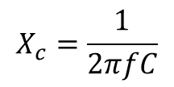

Capacitor in AC
$$V_{s}$$
~
$$I$$
+
$$C$$
$$X_{c}=\frac{1}{2πfC}$$
-
$$V_{C}=X_{c}I_{C}$$
Unit: Ohm $Ω$
Capacitive Reactance

Slide 32

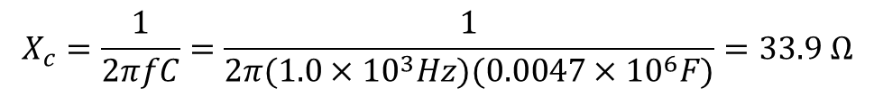


Example
A sinusoidal voltage is applied to a capacitor, as shown in this figure. The frequency of the sine wave is $1.0 KHz.$
Determine the capacitive reactance.
$$X_{c}=\frac{1}{2πfC}=\frac{1}{2π(1.0×{10}^{3}Hz)(0.0047×{10}^{6}F)}=33.9 Ω$$
~
$$I$$
+
$$V_{s}$$
$$C=0.0047 μF$$
-

Slide 33

Quiz
Determine the frequency required to make the capacitive reactance in this figure equal to $10 KΩ.$
~
$$I$$
+
$$V_{s}$$
$C$= $0.0047 μF$
-
Answer
3.39 kHz

Slide 34



Reactance for Series Capacitors
$${X_{C}}_{1}$$
$${X_{C}}_{2}$$
$$X_{T}=X_{C_{1}}+X_{C_{2}}$$

Slide 35


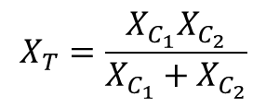
Reactance for Parallel Capacitors
$${X_{C}}_{1}$$
$${X_{C}}_{2}$$
$$X_{T}=\frac{X_{C_{1}}X_{C_{2}}}{X_{C_{1}}+X_{C_{2}}}$$

Slide 36
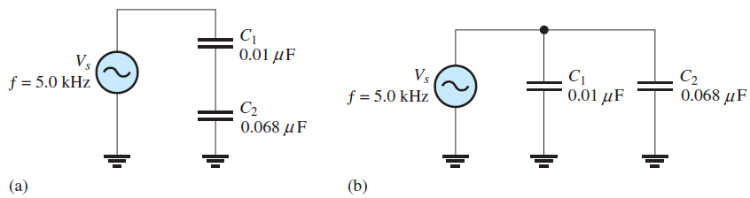
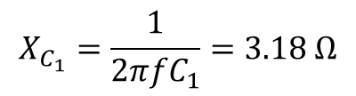
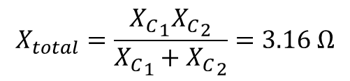

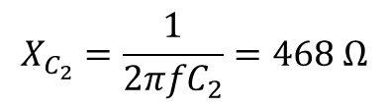
Example
What is the total capacitive reactance in each circuit in this figure?
$$X_{total}=\frac{{X_{C}}_{1}{X_{C}}_{2}}{{X_{C}}_{1}+{X_{C}}_{2}}=3.16 Ω$$
$$X_{C_{1}}=\frac{1}{2πfC_{1}}=3.18 Ω$$
$${X_{total}={X_{C}}_{1}+ X}_{C_{2}}=3.65 Ω$$
$$X_{C_{2}}=\frac{1}{2πfC_{2}}=468 Ω$$

Slide 37



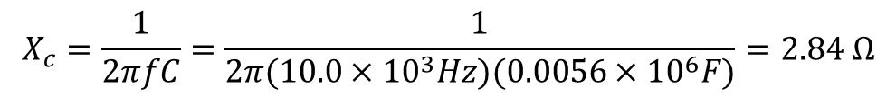

Example
Determine the rms current in this figure.
$$V_{rms}=5$$
$$X_{c}=\frac{1}{2πfC}=\frac{1}{2π(10.0×{10}^{3}Hz)(0.0056×{10}^{6}F)}=2.84 Ω$$
~
$$I$$
+
$C$= $0.0056 μF$
$$f=10KHz$$
-
$I_{rms}=\frac{V_{rms}}{X_{C}}=\frac{5}{2.84 Ω}=1.76 mA$

Slide 38


Quiz
Determine the rms current in this figure.
$$V_{rms}=5$$
~
$$I$$
+
$C$= $0.0056 μF$
$$f=25KHz$$
-
$I_{rms}=4.40 mA$

Slide 39


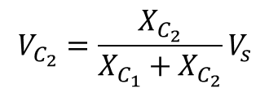

Capacitive Voltage Divider
$${X_{C}}_{1}$$
$$V_{C_{2}}=\frac{X_{C_{2}}}{X_{C_{1}}+X_{C_{2}}}V_{s}$$
$$V_{s}$$
~
$${X_{C}}_{2}$$

Slide 40


Example
What is the voltage across C2 in the circuit?
$V_{2}=\frac{X_{C_{2}}}{X_{C_{1}}+X_{C_{2}}}V_{s}=1.28 V$

Slide 41




RC Circuit
$$R$$
$$C$$
~
In a series RC circuit, the current is the same through both the resistor and the capacitor.
Thus, the resistor voltage is in phase with the current, and the capacitor voltage
lags the current by ${90}^{o}$.Therefore, there is a phase difference of ${90}^{o}$between the resistor
voltage, and the capacitor voltage.

Slide 42





RC Circuit
$$R$$
$$V_{R}$$
$$C$$
~
$$V_{S}$$
$$V_{C}$$
You know from Kirchhoff’s voltage law that the sum of the voltage drops must equal the source voltage. However, since and are out of phase with each other, they must be added as phasor quantities, with
$${V_{s}^{2}=V}_{C}^{2}+V_{R}^{2}$$
$$θ=\tan^{−1}{\frac{V_{C}}{V_{R}}}$$

Slide 43










Example
Determine the source voltage and the phase angle in this figure. Draw the voltage phasor diagram.
$V_{R}=10$
$$R$$
$V_{C}=1$5
$$C$$
~
$$V_{R}$$
$V_{S}=\sqrt{V_{R}^{2}+V_{C}^{2}}=\sqrt{{10}^{2}+{15}^{2}}=18 V$
$$θ={56.3}^{o}$$
$$θ=\tan^{−1}{\frac{V_{C}}{V_{R}}=\tan^{−1}{\frac{15}{10}={56.3}^{o}}}$$
$$V_{S}$$
$$V_{C}$$

Slide 44




Impedance
$$R$$
$$C$$
~
~
$$Z=\sqrt{R^{2}+X_{C}^{2}}$$
$$X_{C}$$

Slide 45










Example
Determine the impedance and the phase angle of the RC circuit in this figure. Draw the impedance triangle.
~
$$Z=\sqrt{R^{2}+X_{C}^{2}}$$
$$R=47 Ω$$
$$C$$
~
$$R$$
$$X_{C}=100Ω$$
$$θ={56.3}^{o}$$
$$Z=\sqrt{R^{2}+X_{C}^{2}}=\sqrt{{47}^{2}+{100}^{2}}=110 Ω$$
$$Z$$
$$θ=\tan^{−1}{\frac{X_{C}}{R}=\tan^{−1}{\frac{100}{47}={64.8}^{o}}}$$
$$X_{C}$$

